Slide 1

Chapter 2
Section 2.2
Console Input Using The Scanner CLASS
Slides prepared by Rose Williams, Binghamton University
Kenrick Mock, University of Alaska Anchorage

Slide 2
Console Input Using the Scanner Class
Starting with version 5.0, Java includes a class for doing simple keyboard input named the Scanner class
In order to use the Scanner class, a program must include the following line near the start of the file:
import java.util.Scanner
This statement tells Java to
Make the Scanner class available to the program
Find the Scanner class in a library of classes (i.e., Java package) named java.util

Slide 3
Console Input Using the Scanner Class
The following line creates an object of the class Scanner and names the object keyboard :
Scanner keyboard = new Scanner(System.in);
Although a name like keyboard is often used, a Scanner object can be given any name
For example, in the following code the Scanner object is named scannerObject
Scanner scannerObject = new Scanner(System.in);
Once a Scanner object has been created, a program can then use that object to perform keyboard input using methods of the Scanner class

Slide 4
Console Input Using the Scanner Class
The method nextInt reads one int value typed in at the keyboard and assigns it to a variable:
int numberOfPods = keyboard.nextInt();
The method nextDouble reads one double value typed in at the keyboard and assigns it to a variable:
double d1 = keyboard.nextDouble();
Multiple inputs must be separated by whitespace and read by multiple invocations of the appropriate method
Whitespace is any string of characters, such as blank spaces, tabs, and line breaks that print out as white space

Slide 5
Console Input Using the Scanner Class
The method next reads one string of non-whitespace characters delimited by whitespace characters such as blanks or the beginning or end of a line
Given the code
String word1 = keyboard.next();
String word2 = keyboard.next();
and the input line
jelly beans
The value of word1 would be jelly, and the value of word2 would be beans

Slide 6
Console Input Using the Scanner Class
The method nextLine reads an entire line of keyboard input
The code,
String line = keyboard.nextLine();
reads in an entire line and places the string that is read into the variable line
The end of an input line is indicated by the escape sequence '\n'
This is the character input when the Enter key is pressed
On the screen it is indicated by the ending of one line and the beginning of the next line
When nextLine reads a line of text, it reads the '\n' character, so the next reading of input begins on the next line
However, the '\n' does not become part of the string value returned (e.g., the string named by the variable line above does not end with the '\n' character)

Slide 7
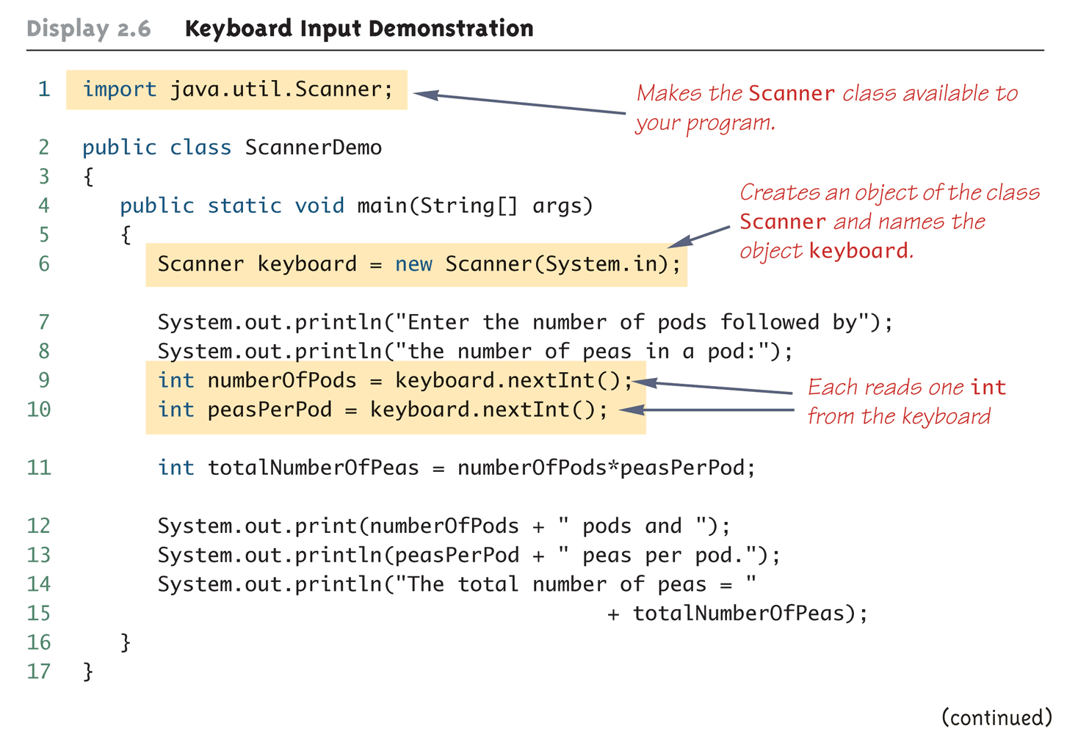
Keyboard Input Demonstration (Part 1 of 2)

Slide 8
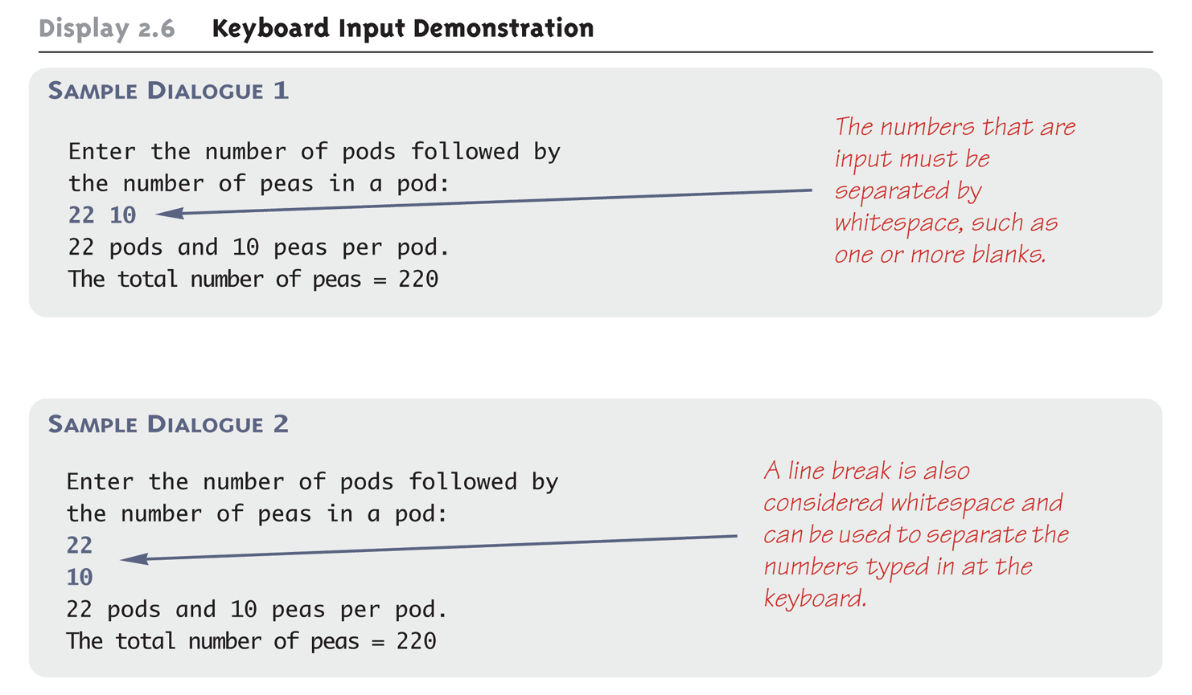
Keyboard Input Demonstration (Part 2 of 2)

Slide 9
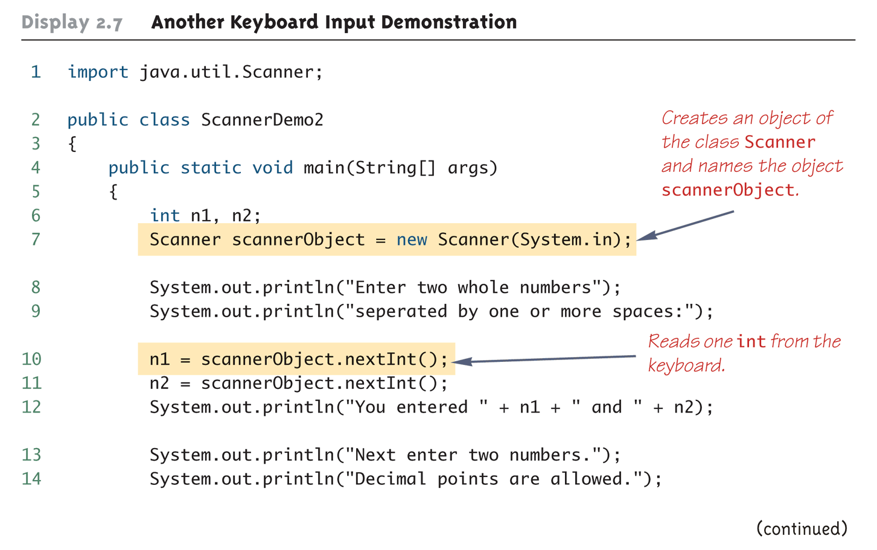
Another Keyboard Input Demonstration (Part 1 of 3)

Slide 10
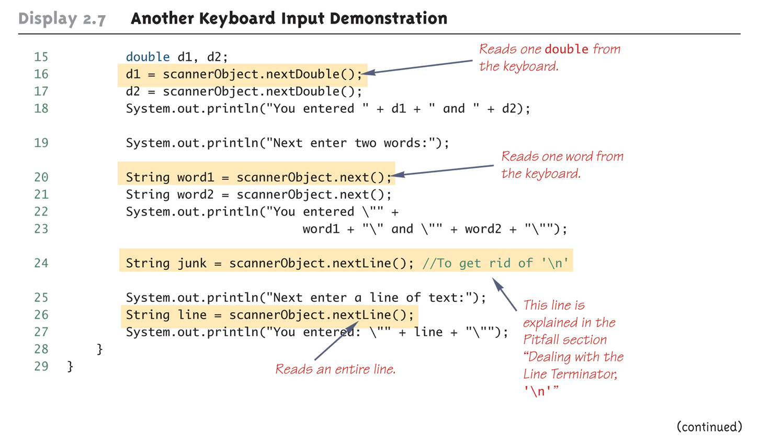
Another Keyboard Input Demonstration (Part 2 of 3)

Slide 11
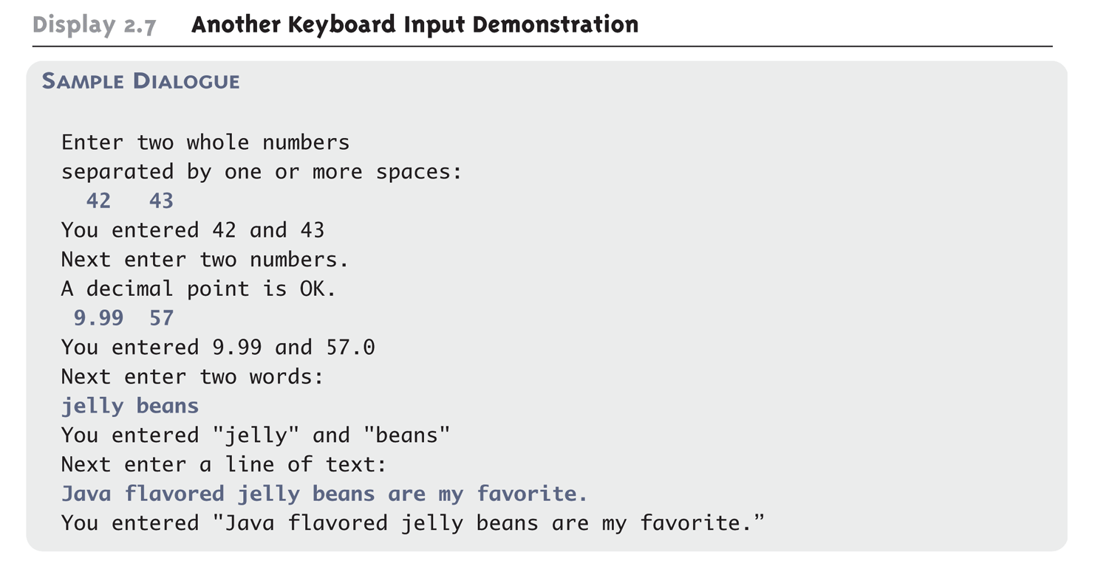
Another Keyboard Input Demonstration (Part 3 of 3)

Slide 12
Pitfall: Dealing with the Line Terminator, '\n'
The method nextLine of the class Scanner reads the remainder of a line of text starting wherever the last keyboard reading left off
This can cause problems when combining it with different methods for reading from the keyboard such as nextInt
Given the code,
Scanner keyboard = new Scanner(System.in);
int n = keyboard.nextInt();
String s1 = keyboard.nextLine();
String s2 = keyboard.nextLine();
and the input,
2
Heads are better than
1 head.
what are the values of n, s1, and s2?

Slide 13
Pitfall: Dealing with the Line Terminator, '\n'
Given the code and input on the previous slide
n will be equal to "2",
s1 will be equal to "", and
s2 will be equal to "heads are better than"
If the following results were desired instead
n equal to "2",
s1 equal to "heads are better than", and
s2 equal to "1 head"
then an extra invocation of nextLine would be needed to get rid of the end of line character ('\n')

Slide 14
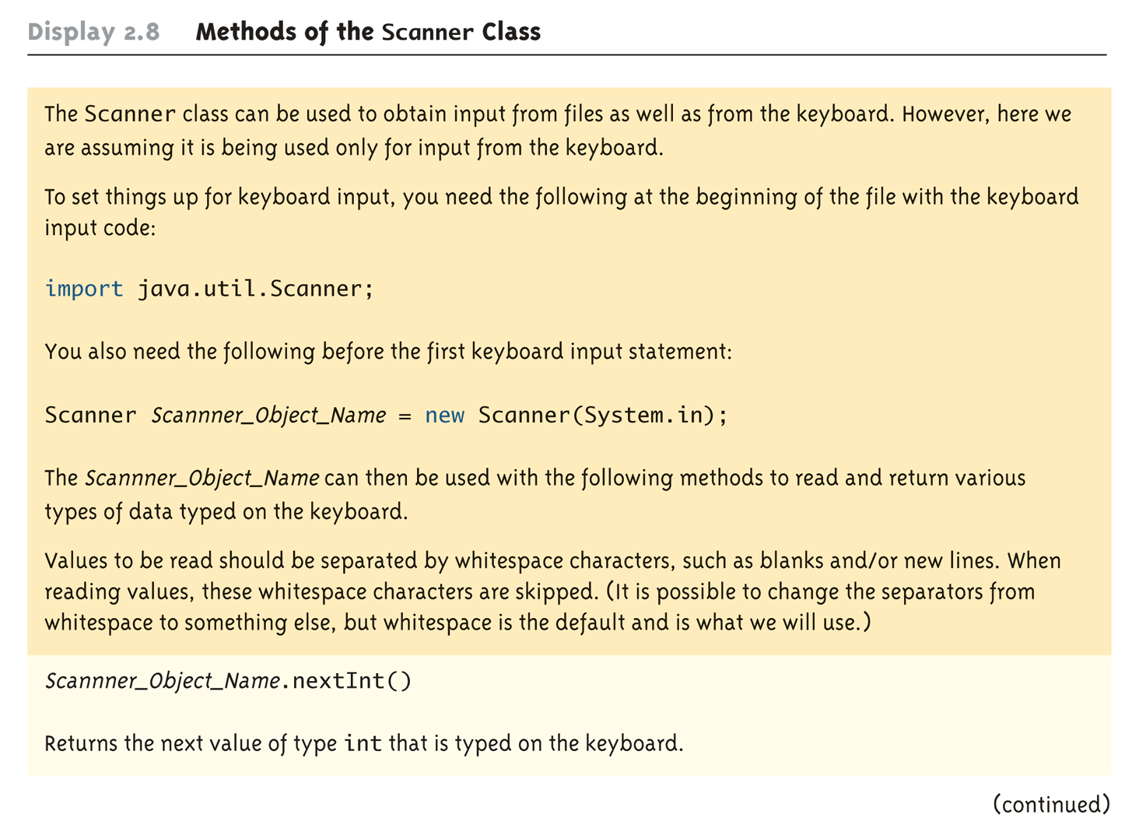
Methods in the Class Scanner (Part 1 of 3)

Slide 15
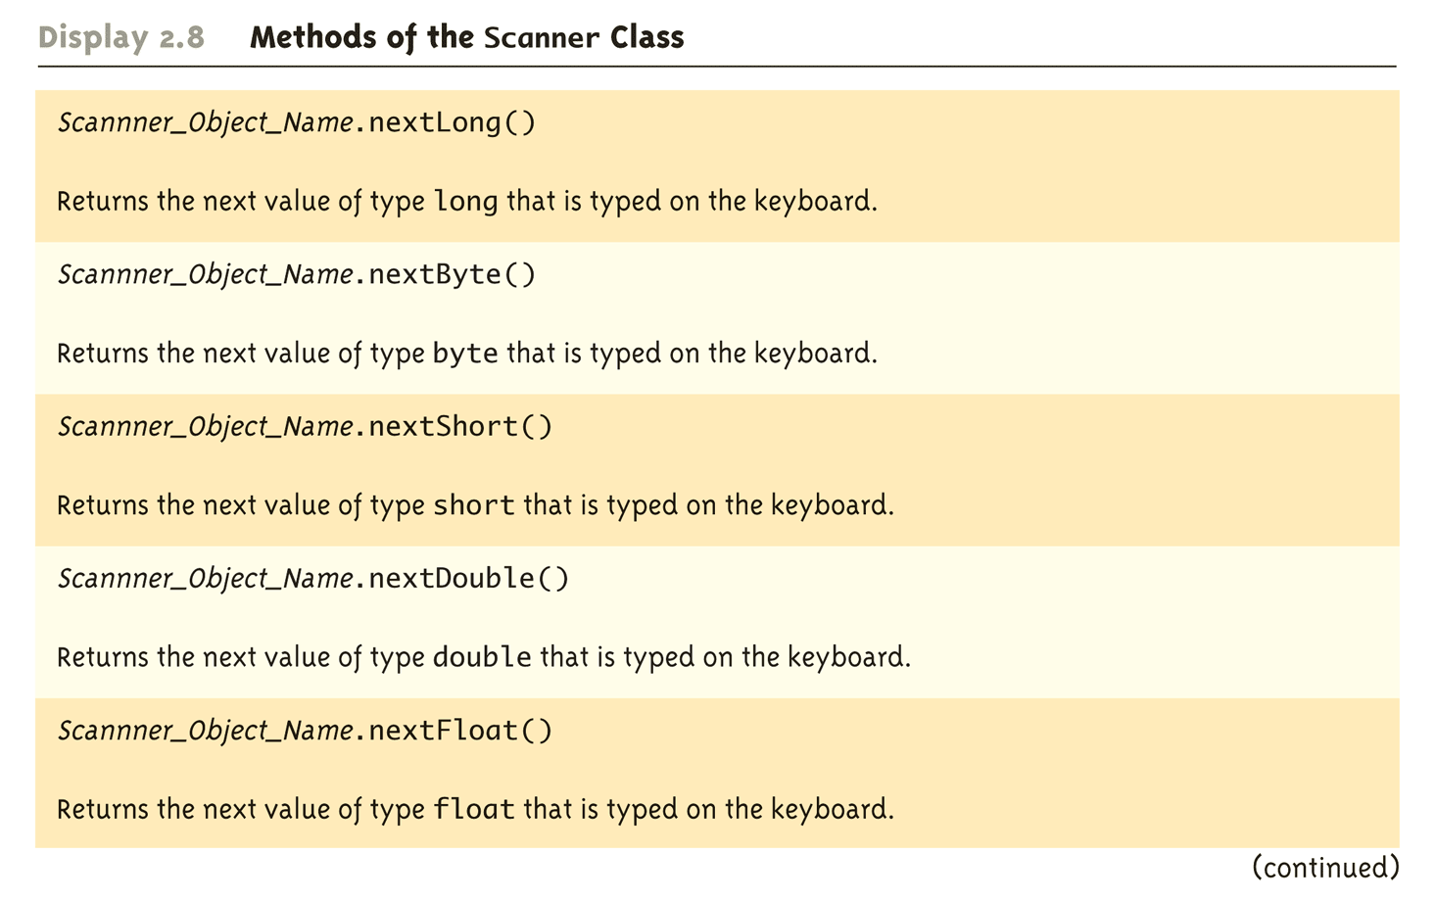
Methods in the Class Scanner (Part 2 of 3)

Slide 16
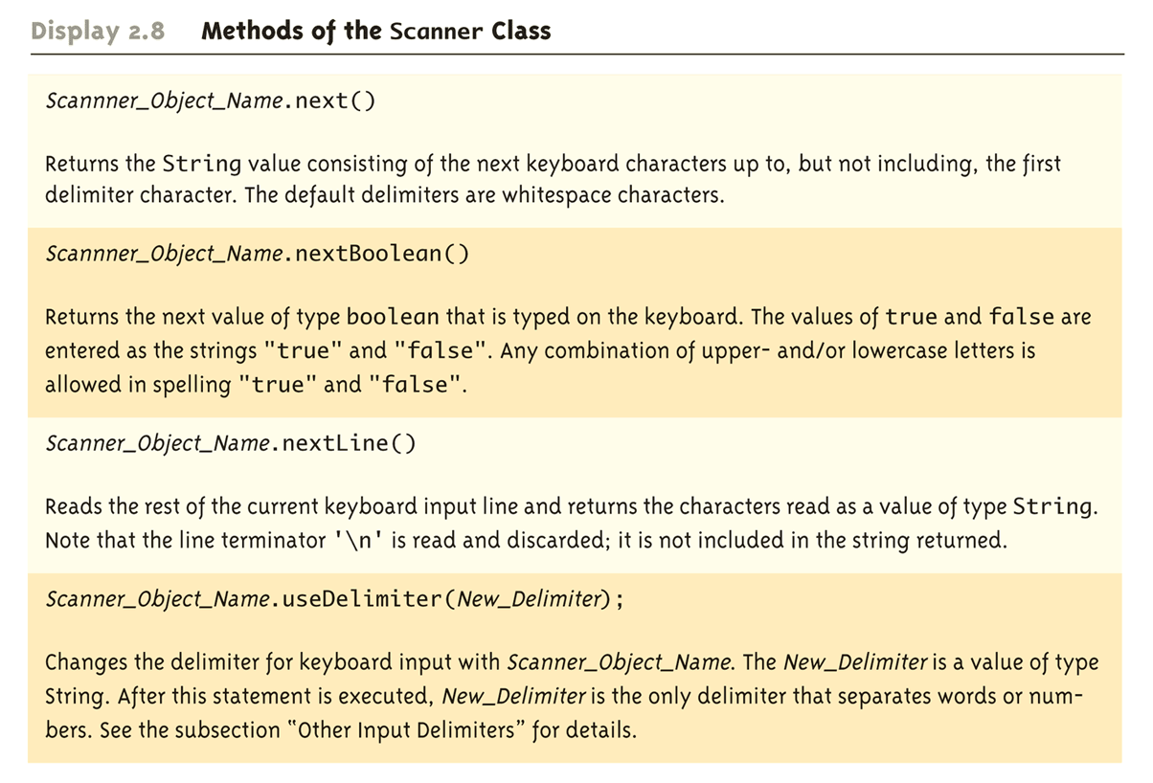
Methods in the Class Scanner (Part 3 of 3)

Slide 17
Programming Tip: Prompt for Input
A program should always prompt the user when he or she needs to input some data:
System.out.println(
"Enter the number of pods followed by");
System.out.println(
"the number of peas in a pod:");

Slide 18
The Empty String
A string can have any number of characters, including zero characters
"" is the empty string
When a program executes the nextLine method to read a line of text, and the user types nothing on the line but presses the Enter key, then the nextLine Method reads the empty string

Slide 19
Other Input Delimiters
The delimiters that separate keyboard input can be changed when using the Scanner class
For example, the following code could be used to create a Scanner object and change the delimiter from whitespace to "##"
Scanner keyboard2 = new Scanner(System.in);
keyboard2.useDelimiter("##");
After invocation of the useDelimiter method, "##" and not whitespace will be the only input delimiter for the input object keyboard2

Slide 20
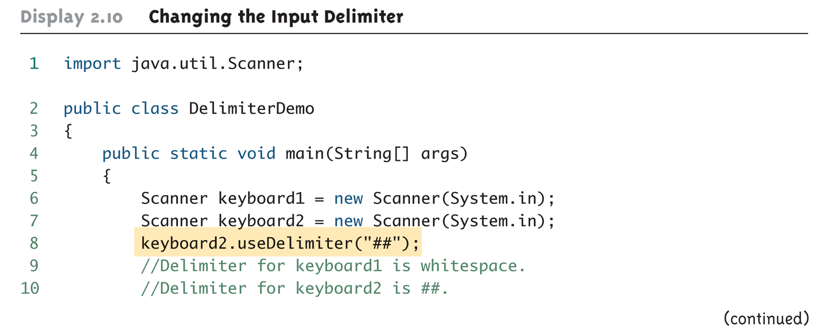
Changing the Input Delimiter (Part 1 of 3)

Slide 21
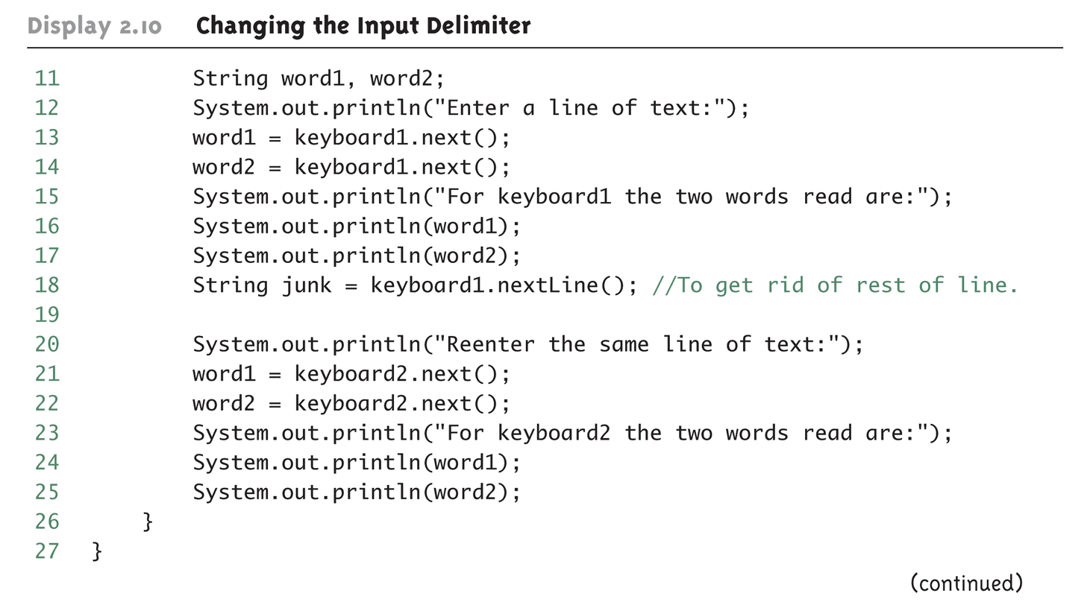
Changing the Input Delimiter (Part 2 of 3)

Slide 22
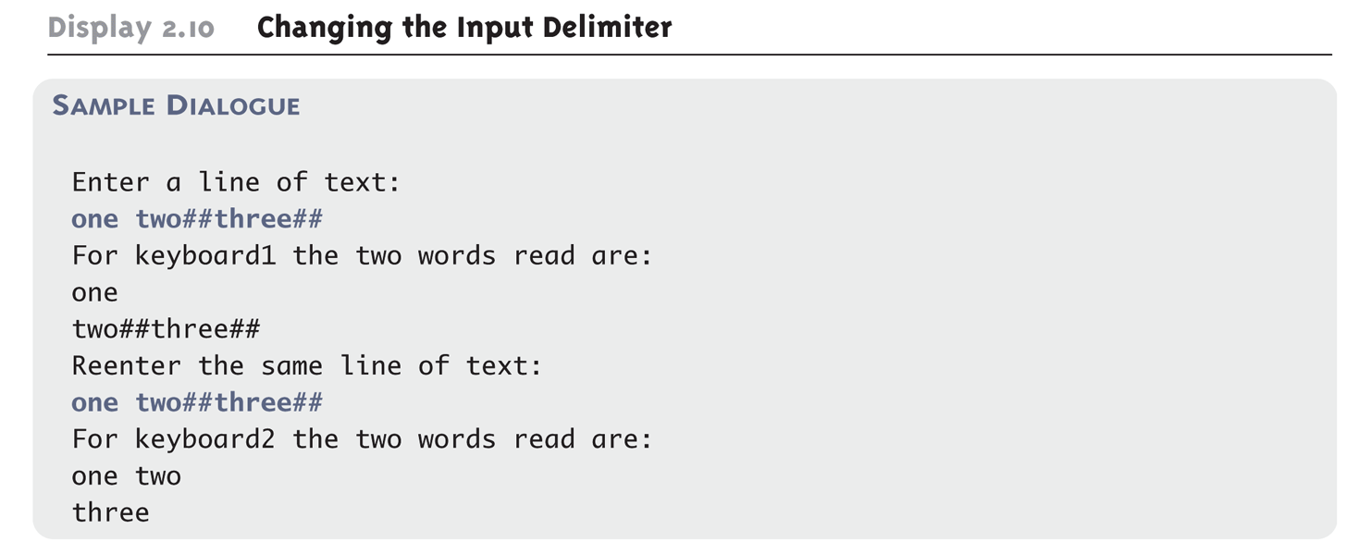
Changing the Input Delimiter (Part 3 of 3)

